Slide 1

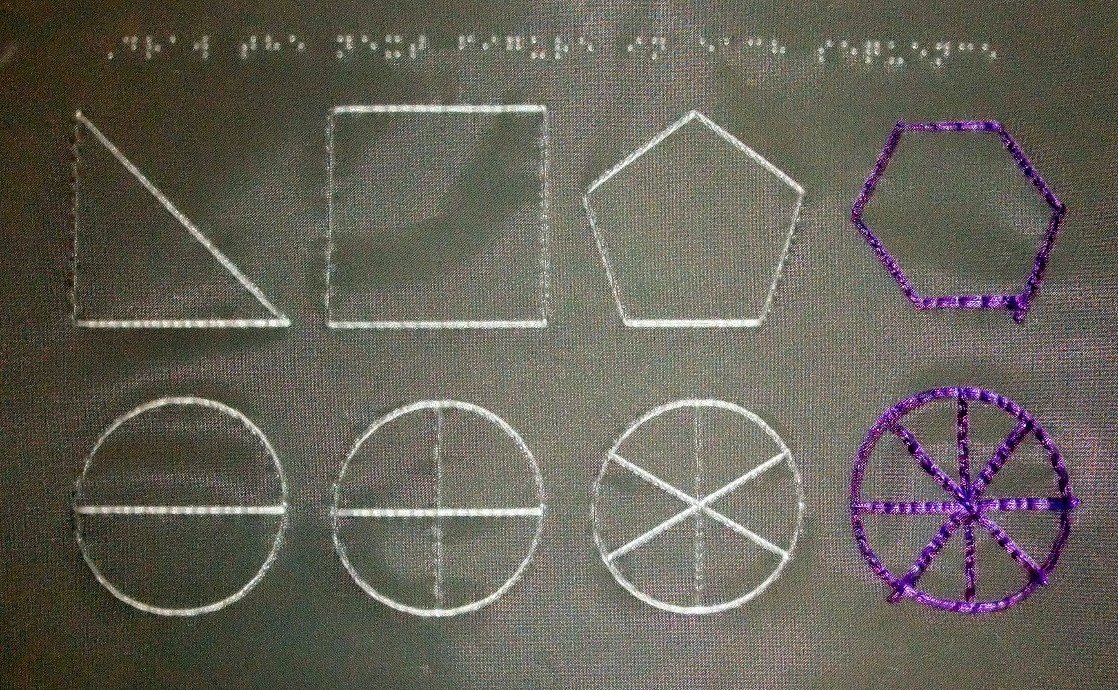

Interactive Tactile Graphics
in preK-12 Education
Mike Coleman, Mike Rosen,
and, Josh Coffee E.A.S.Y. LLC
Burlington, VT
Tactile Graphics in Education and Careers
October 11–12, 2018
National Federation of the Blind Jernigan Institute
Baltimore, MD

Slide 2
Talks will be available for download at:
http://www.easytactilegraphics.com/POSB2017/

Slide 3
My Relevant Background
Mechanical Engineering – IBM, Faculty UVM
STEM Education, freehand drawing instruction
Fine Arts, Illustration – drawing, painting, sculpture, textbook illustration

Slide 4
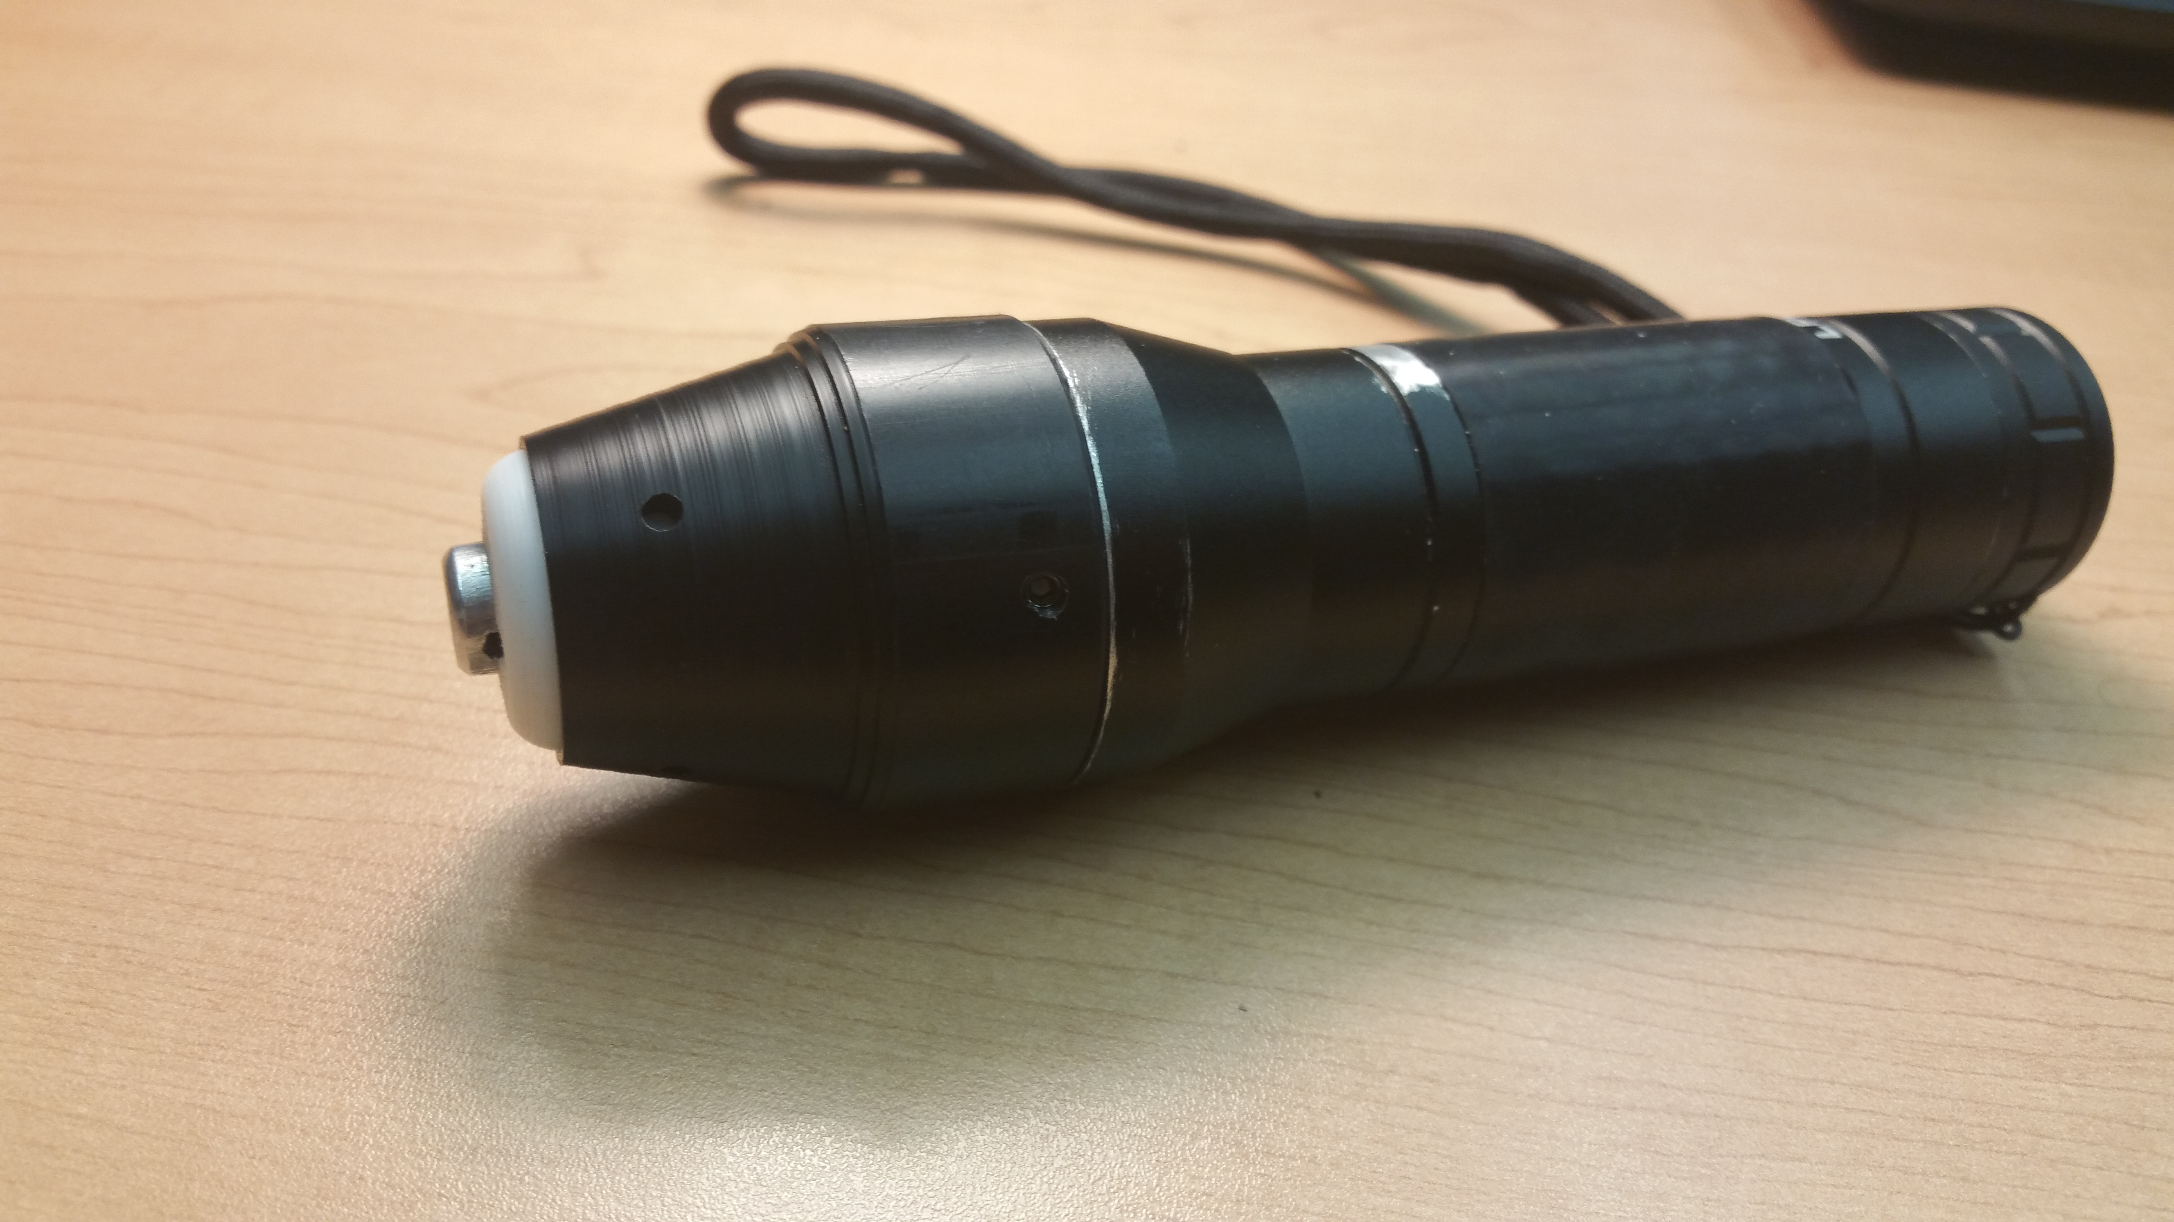
historical aside #1
E.A.S.Y. LLC started as SEED project at UVM with NFB support
Founded in 2011, again with NFB support,
by two faculty and one student
Home is UVM incubation site for start-ups
Earliest credible approval from Susan O. and TSBVI colleagues
Our main product: the inTACT Sketchpad
Other product, right now: the Eraser.
“To draw is human; to edit is divine.”

Slide 5
time for group participation:
tic-tac-toe

Slide 6
Take-away Themes, Messages
Drawing is a spatial skill, not a visual skill (2014).
Everyone can learn to draw well and use drawing.
Draw early; draw often.
It’s not okay for kids to be told to skip graphics in school.
Drawing is fun and useful!
Learn to Draw; Draw to Learn.
‘Read-write’ tactile graphics; not just ‘read-only’ pre-prepared graphics -> e.g., interactive tactile graphics worksheets

Slide 7
Take-away Themes, Messages
Raise expectations, increase opportunities –
Mark Riccobono

Slide 8
Tactile Graphics Advocacy – a Paradigm Shift
Resolution 2013-08: Regarding Tactile Fluency
Crafted together with leadership and members of the NFB (Al Maneki)
WHEREAS, it is commonplace for sighted students to acquire both literacy and drawing skills through a gradual progression of improvement, beginning at the earliest possible age, resulting in adults who have developed proficiency in literacy and graphics; and
WHEREAS, in the blind population, not only is insufficient attention given to Braille instruction, but virtually no attention is given to exploring our environment by touch and representing our tactile observations in a tactile medium; and
WHEREAS, competence in tactile graphics refers collectively to the techniques of drawing raised lines, circles, and other curves; developing the ability to feel and interpret a tactile image efficiently; developing an understanding of three-dimensional objects drawn in two dimensions; and, finally, appreciating inherently visual ideas of perspective and scale; and

Slide 9
WHEREAS, the combination of proficiencies in Braille and tactile graphics is expressed by the term tactile fluency; and
WHEREAS, the historic lack of emphasis on tactile graphics was due partly to the general unavailability of simple devices on which tactile images could be drawn, edited, transmitted, and reproduced; and
WHEREAS, the ability of blind people to read Braille and to create and interpret tactile graphic images is highly relevant in modern society; and
WHEREAS, the widespread belief that blind people are innately less able to construct and interpret graphic images is a misconception resulting from the lack of opportunities to develop a facility with graphics, and not due to the mere lack of eyesight; and

Slide 10
BE IT RESOLVED by the National Federation of the Blind in Convention assembled this fifth day of July, 2013, in the city of Orlando, Florida, that this organization urge colleges and universities to revamp their curricula for teachers of blind students to require them to demonstrate competencies in both Braille and the graphic aspects of tactile fluency; and
BE IT FURTHER RESOLVED that we urge the instruction in tactile fluency for all blind children to begin at the earliest possible age; and
BE IT FURTHER RESOLVED that this organization urge rehabilitation agencies serving the blind to provide their counselors with a thorough appreciation of the need for tactile fluency and up-to-date information about the latest tactile fluency devices and techniques.
BE IT FURTHER RESOLVED that we continue to work with companies and interested parties in the development of more advanced
tactile fluency tools.

Slide 11
Freehand Tactile Raised Line Drawing – an Introduction
Why do you use Freehand Tactile Drawing?
Examples ahead ….
When should students be introduced to Freehand Tactile Drawing?
  Early, and earlier.
Manual Drawing devices: inTACT Sketchpad,
APH Draftsman, TactiPad, the Blackboard, the Sewell Kit
  Tactile Drawing Tools – rulers, compasses, etc.
  User Friendly (Particularly young children)
  Useful for developing Tactile Fluency
Figure 1: E.A.S.Y. inTACT Sketchpad with a typical freehand raised-line sketch – two stick figures and a cat.

Slide 12
Why Freehand Tactile Drawing?
Being able to express oneself graphically or pictorially –- in the simplest and most general sense of using purposefully organized lines on paper to communicate information without words –- can be a useful and powerful skill.
Freehand drawing - one of the most ubiquitous and oldest modes of ‘graphical’, non-verbal communication, nearly essential for expressing ideas from the simplest to the most complicated, in any activity. Cave drawing -> tablet PC!

Slide 13
In everyday life, science , math, design, engineering, art - drawing is for:
Depiction of what of what one perceives or imagines
Communication of ideas and information
Understanding a problem
Analysis, interpretation of data
Enhancement of the creative process in general, etc.
But, also - pleasure, relaxation, meditation, agitation …

Slide 14
Ex.: Drawing for Mechanical Engineering problem solving: Free Body Diagrams – interactive exercise

Slide 15
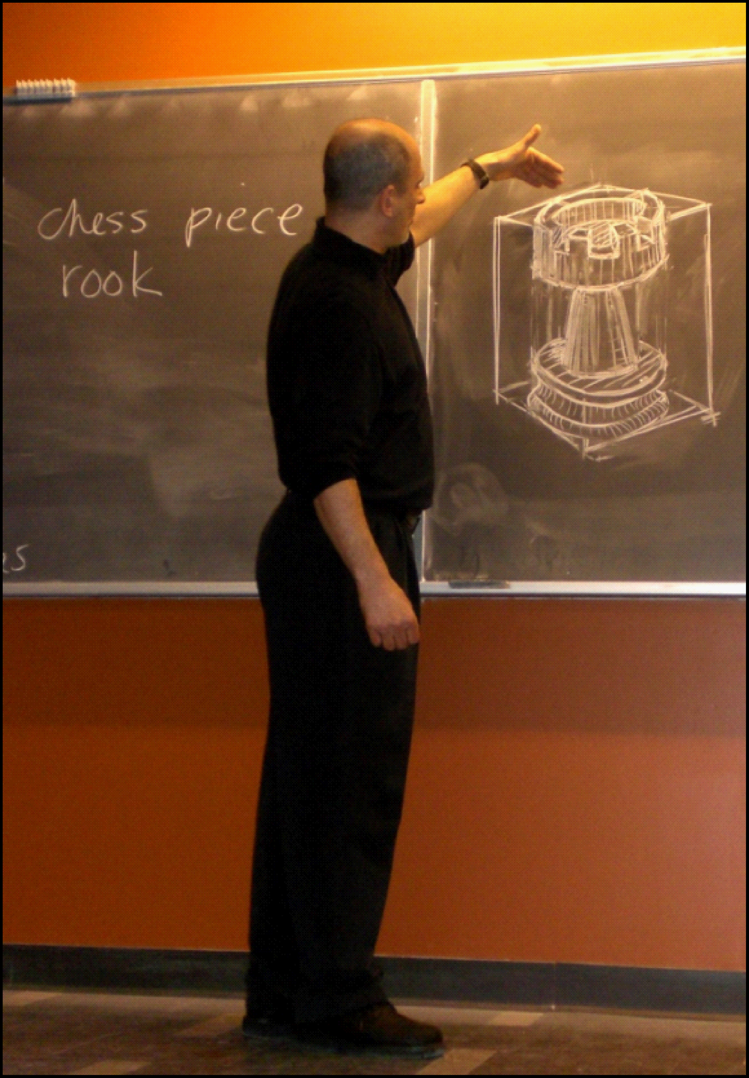
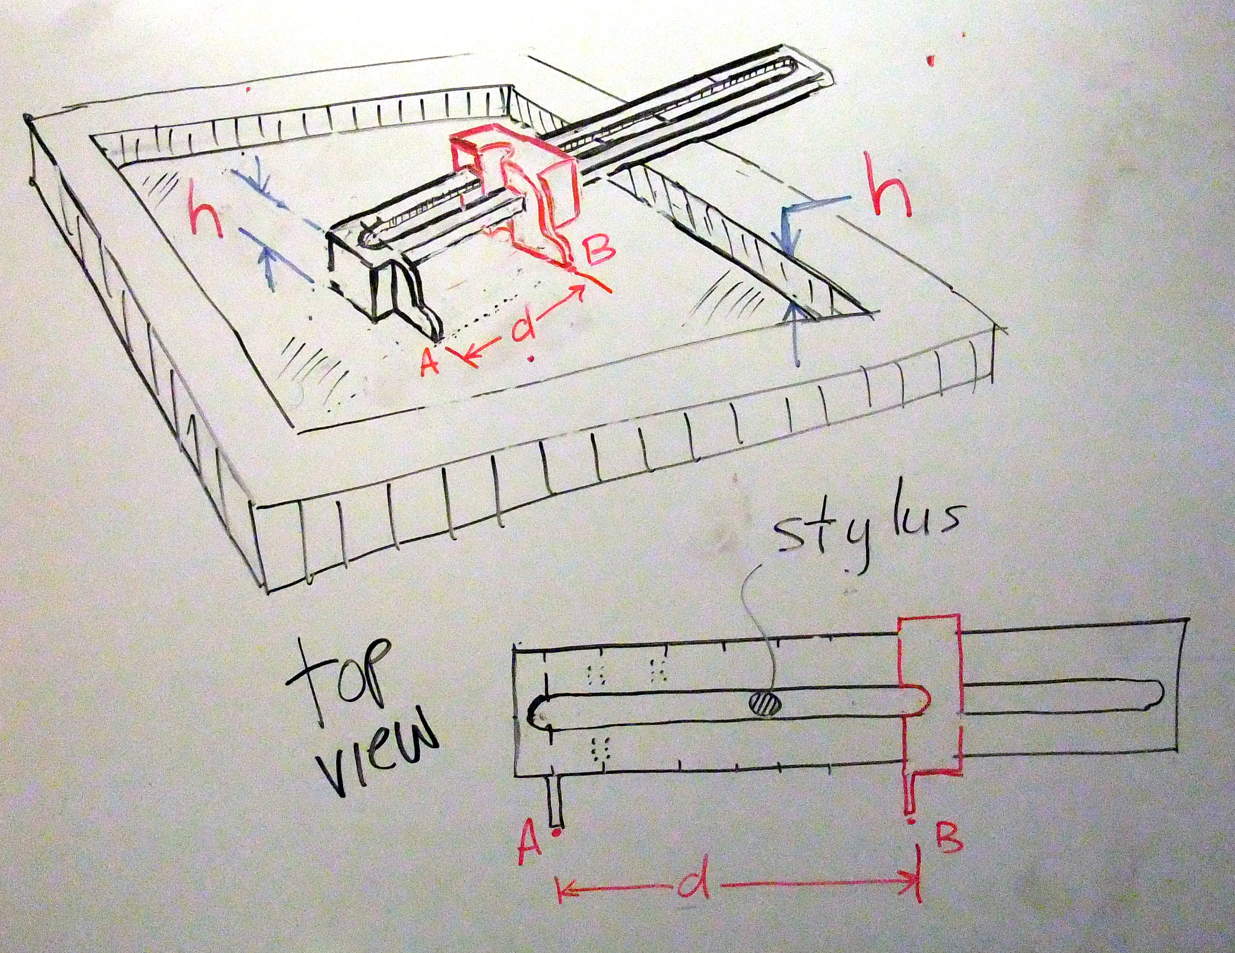
Ex.: Freehand drawing for engineering analysis and design
Tactile Graphics Ruler Design: Margaret Edwards, Susan Osterhaus, Scott Kelley(TSBVI) and EASY ….

Slide 16
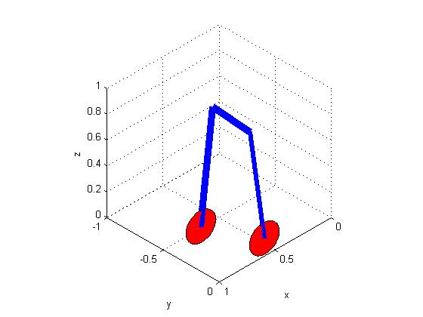
Ex.: Freehand drawing skills -> automated drawing tools for engineering analysis and design
Computer Aided Design (CAD)
MATLAB
Adobe Illustrator

Slide 17
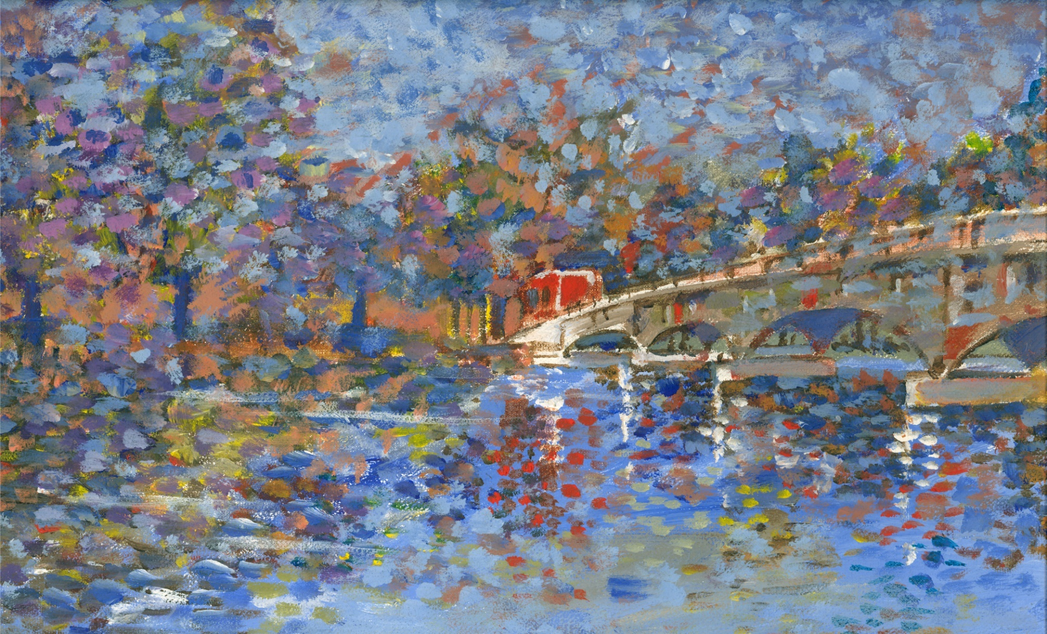
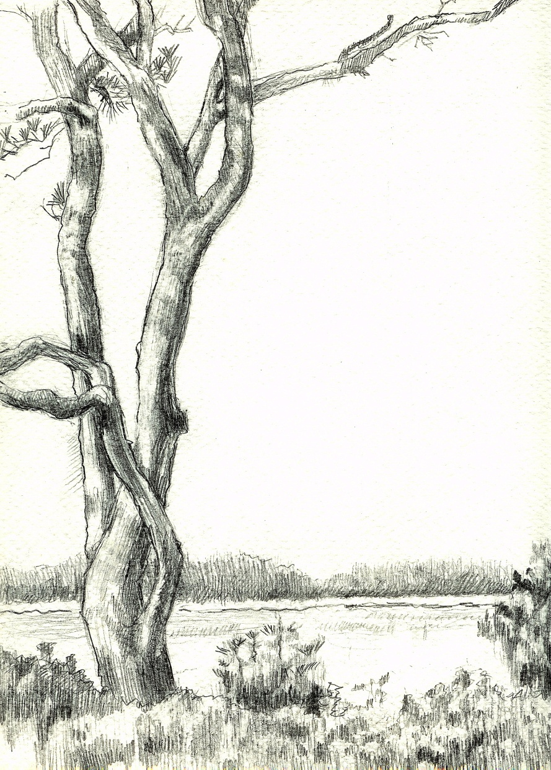
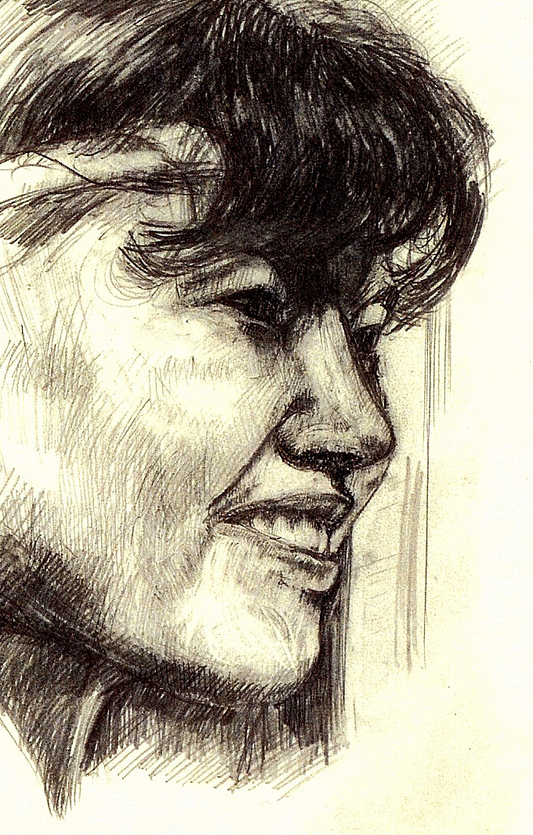
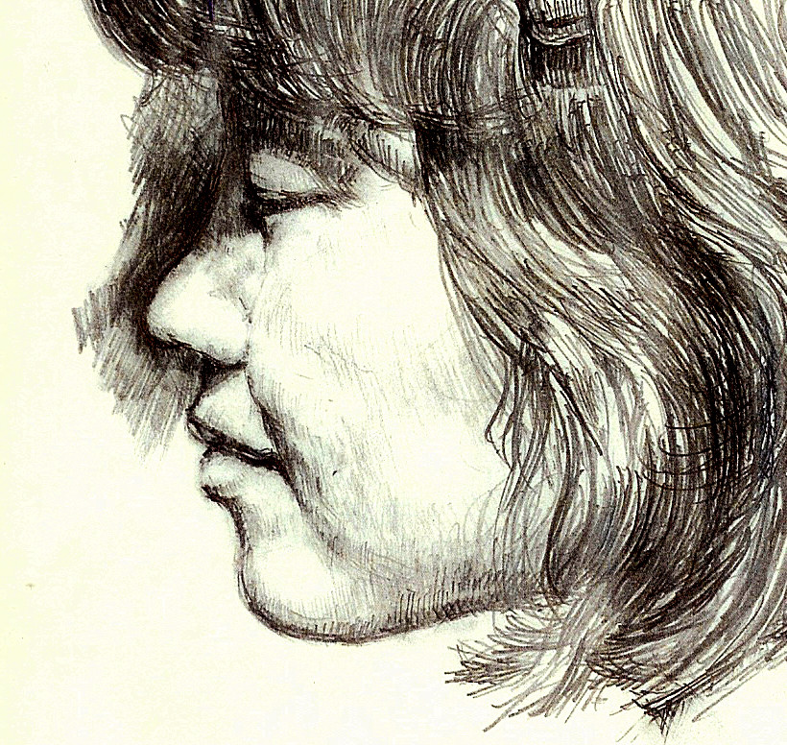
Ex.: Art,
Illustration

Slide 18
Interactive Graphics Worksheets:
What are Interactive Tactile Graphics Worksheets?
  exercises with pre-printed drawings, images, graphs, etc.
  Exercises require student completion by drawing on tactile worksheet
  Examples include connect-the-dots, graphing functions on grid paper, drawing symmetry lines of shapes, bisecting angles, drawing in the parts of a cell, etc.
Why are Interactive Graphics Exercises important?
  Develop skills necessary to communicate graphically – Graphical Fluency
  Practice and demonstrate skills required by Common Core
  Succeed in STEM fields in all levels of education and beyond
  Develop creative potential
Using the inTACT Sketchpad for Interactive Graphics
  Preparing Exercises by teacher
  Interacting with students / Student-to-Student interaction
  Exams / Assessments

Slide 19
Interactive Graphics Worksheets: the Common Core and Beyond …
Common Core State Standards (CCSS), the Next Generation Science Standards(NGSS) - require competence with drawing doing math and science. EXAMPLE? WORKBOOKS!
Drawing is a spatial skill derived from using some or all of our senses, and so not exclusively visual; thus, mass-produced ink-print workbooks for the sighted that require drawing are not accessible to the blind and sight-impaired.
No publicly available accessible workbooks exist for BVI students.While the worksheets can be made tactile and thus “readable” by BVI students – these students cannot complete the exercises because they cannot draw on most tactile graphics media.

Slide 20
Exercises Requiring Drawing- Geometry
Drawing is a substantial requirement of Common Core for Geometry as early as Grade 2
  From CCSS.Math.Content.2.G.A.1
  “Recognize and draw shapes having specified attributes, such as a given number of angles or a given number of equal faces.¹ Identify triangles, quadrilaterals, pentagons, hexagons, and cubes.”
Example – Grade 4 – Symmetry
  From CCSS.Math.Content.4.G.A.3
“Recognize a line of symmetry for a two-dimensional figure as a line across the figure such that the figure can be folded along the line into matching parts. Identify line- symmetric figures and draw lines of symmetry.”
Examples – Grade 7 – Bisecting Angles and Constructing Triangles
    Bisect Angles
    Draw Altitudes of Triangles
    Draw Triangles from verbal description

Slide 21
Standardized Worksheet Templates – Graph / Grid Paper and More …
inTACT Printer can produce multiple copies of generic Interactive Drawing Worksheets
  Grid Paper
  Graph Paper (1,2 or 4 Quadrant(s))
  Pie Charts
  Venn Diagrams
  Number Bonds, and more …
Example – Grade5 - 7 – Graphing on Coordinate Plane
    Plot the following points: (0,0); (1,1); (3,2); (4,4); (5,4); (7,5) CCSS.Math.Content.5.G.A.2
    Draw a polygon with the following Vertices: (0,2); (1,4); (3,4); (2,2) CCSS.Math.Content.6.G.A.3
More Examples
  Geometric Translation / Scaling / Rotation / Reflection CCSS.Math.Content.HSG.CO.A.5
  Plot data points
  Plot functions CCSS.Math.Content.8.F.B.5, CCSS.Math.Content.HSF.IF.B.4

Slide 22
High School and beyond –
Trigonometry
  Plotting trig expressions
  Understanding relationships between trig functions
Calculus
  Slopes of curves / Tangent lines
  Mark area of integration under a curve.
Geometry Constructions
  Perpendicular Bisectors
  Find Circle Centers

Slide 23
Ideas
Exercises Requiring Drawing- NGSS
Main Subject Areas are Physical Sciences, Life Sciences, and Earth and Space Sciences
Drawing is a substantial requirement of NGSS K-12: Examples …
“Foundations”
  Science and Engineering Practices
    Models
    “Modeling in K–2 builds on prior experiences and progresses to include using and developing models (i.e., diagram, drawing, physical replica, diorama, dramatization, storyboard) that represent concrete events or design solutions.”
    Obtaining, Evaluating, and Communicating Information
      “Communicate solutions with others in oral and/or written forms using models and/or drawings that provide detail about scientific ideas.”
  Disciplinary Core
    Developing Possible Solutions
      “Designs can be conveyed through sketches, drawings, or physical models. These representations are useful in communicating ideas for a problem’s solutions to other people.”
From - NEXT GENERATION SCIENCE STANDARDS, For States, By States
Volume 1: The Standards—Arranged by Disciplinary Core Ideas and by Topics, The National Academies Press

Slide 24
Ideas
Exercises Requiring Drawing- NGSS, cont.
Performance Expectations examples – students can:
  Engineering Design -
    K-2-ETS1-2. “Develop a simple sketch, drawing, or physical model to illustrate how the shape
    an object helps it function as needed to solve a given problem.”
  Matter and Its Interactions
    MS-PS1-1. “Develop models to describe the atomic composition of simple molecules and extended structures.
    Examples of molecular-level models could include drawings, three-dimensional ball and stick structures, or computer representations showing different molecules with different types of atoms.”
    MS-PS1-4. “Develop a model that predicts and describes changes in particle motion, temperature,
    and state of a pure substance when thermal energy is added or removed. Examples of models could include
    drawings and diagrams.”
  Energy
    HS-PS3-2. “Develop and use models to illustrate that energy at the macroscopic scale can be accounted for
    as a combination of energy associated with the motion of particles (objects) and energy associated with the relative positions of particles (objects). Examples of models could include diagrams, drawings, descriptions...”

Slide 25
historical aside #2
Small business grants – SBIR and STTR
We received an NIH Phase I, feasibility demonstration, in 2013…
… and Phase II, ~$1M in 2015.
Goal1: develop the inTACT Printer
  Prints interactive tactile worksheets from computer files or ad hoc
  Includes Braille annotation and variable line heights and sheet feed
Goal 2: evaluate the inTACT Printer and example worksheets with…
TSBVI | Perkins School
Louisiana Center | VABVI
Pearson | NFB
GH | AIR

Slide 26
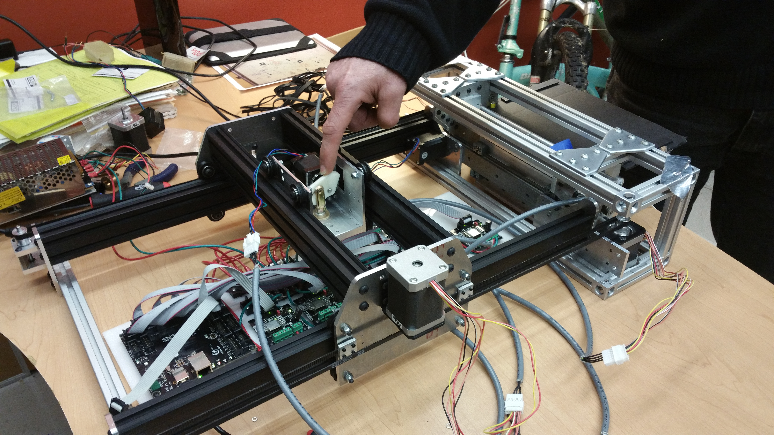
Grant Progress and Status: engineering
Brailling system complete. First-ever annotated interactive tactile worksheets.
Programmed control of line height: system complete.
Beta inTACT Printer prototype 1.0 completed
Custom circuitry for prototype 2.0 nearing completion at GH.
Design iteration of the feed and clamping system continuing

Slide 27
EASY intact Printer

Slide 28
Grant Progress; Student and Professional Evaluators so far
TSBVI
  six faculty and professional staff
  twenty students
Perkins
  three faculty
  six students
LA Center: two faculty/admin
NFB: two education specialists/program leaders, plus instructors at particular State BELL’s (planned)

Slide 29
Grant Progress: Evaluation courses and content
TSBVI: 15 worksheets
  3rd grade 3-session geometry short course. Margaret Edwards and John Rose. Instructor-originated.
  Grades 8-11, “math tools” short course. Susan Osterhaus and Margaret Edwards. instructor originated.
  7th period geometry, from TEKS Geometry
Perkins: 14 worksheets
  4th grade math, fractions: Becky Vercollone and Elise Edwards, from text
  Two students, templates for practicing signature, instructor originated
LA Center: 10 generics selected from 30
  Generics, including Bohr model, circle with tic marks, clock faces, graph paper, 4-way intersection, pie chart, thermometer with tic marks, Venn diagram, US outline, body outline
NFB BELL
  “Learn to Draw, Draw to Learn”: at-home adjunct to daily Braille content

Slide 30
E.A.S.Y NIH Phase II Grant Progress: Printer and Interactive Tactile Graphics Worksheets
Added Brailling capacity and varying line height on inTACT Drawing sheets. Produced the first ever annotated Tactile Graphics Worksheets for BLV students.
Finalized Design of a beta-prototype inTACT Printer
Developed Custom interactive worksheets for use by students at TSBVI, Perkins School, and the LA Center
Developed interactive generic worksheets for the LA Center in math, science, geography, O&M, etc.
Collaborating with the NFB, Perkins School for the Blind, Texas School for the Blind and Visually Impaired, LA Center for the Blind, Vermont Association for the Blind and Visually Impaired, American Institutes for Research, gh, and Pearson Publishing to incorporate inTACT Worksheets into current programming, curricular development, and testing platforms. THANK YOU –WE ARE GRATEFUL!!!

Slide 31
E.A.S.Y NIH Phase II Grant: Collaboration Strategy for Worksheet Evaluation
“...To make a good work plan for investigating the use and effectiveness of interactive worksheets depends heavily on getting your guidance and input on subject matter, educational level, classroom strategy, classroom materials, teacher buy in/training as necessary, etc. - that first and foremost work for you and your students in your teaching settings.”
“We are excited to be working with you to advance the incorporation of pre-printed interactive tactile graphics learning materials into the curriculum for blind students. Formalizing a tidy, streamlined, focused plan with your expert guidance that can dovetail as easily as possible with your existing classroom goals and agendas with minimal disruption is what we are aiming for. ”

Slide 32
Examples of Tactile Graphics Worksheets
Texas School for the Blind and Visually Impaired (Susan Osterhaus, Margaret Edwards, John Rose)
Figure 2: Test Question 2: Draw with Stencil.
Feel the shape printed on the sheet. Circle the correct name in the list printed
below the shape. Find stencil of same shape. Use the stencil to draw a
copy to the right.
Handout Alert!
Square Triangle Rhombus Circle

Slide 33
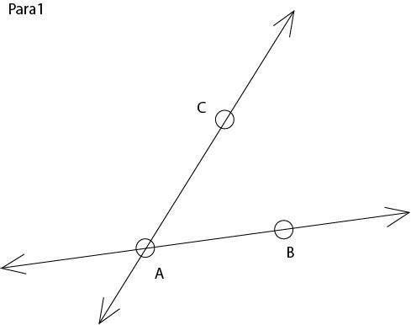
Examples of Tactile Graphics Worksheets
(cont.)
Texas School for the Blind and Visually Impaired (Maylene Bird, Scott Kelley)
Parallel lines. Draw a line parallel to line AB through point C not on AB using a compass and a straight edge, as follows.
  Copy angle CAB so that C is the vertex of the new angle using a compass. Label the points of intersection D and E.
  Draw CD using a straight edge.
Figure 3: Geometry Exercises: Construction, p. 207; TEKS Geometry (McGraw-Hill).

Slide 34
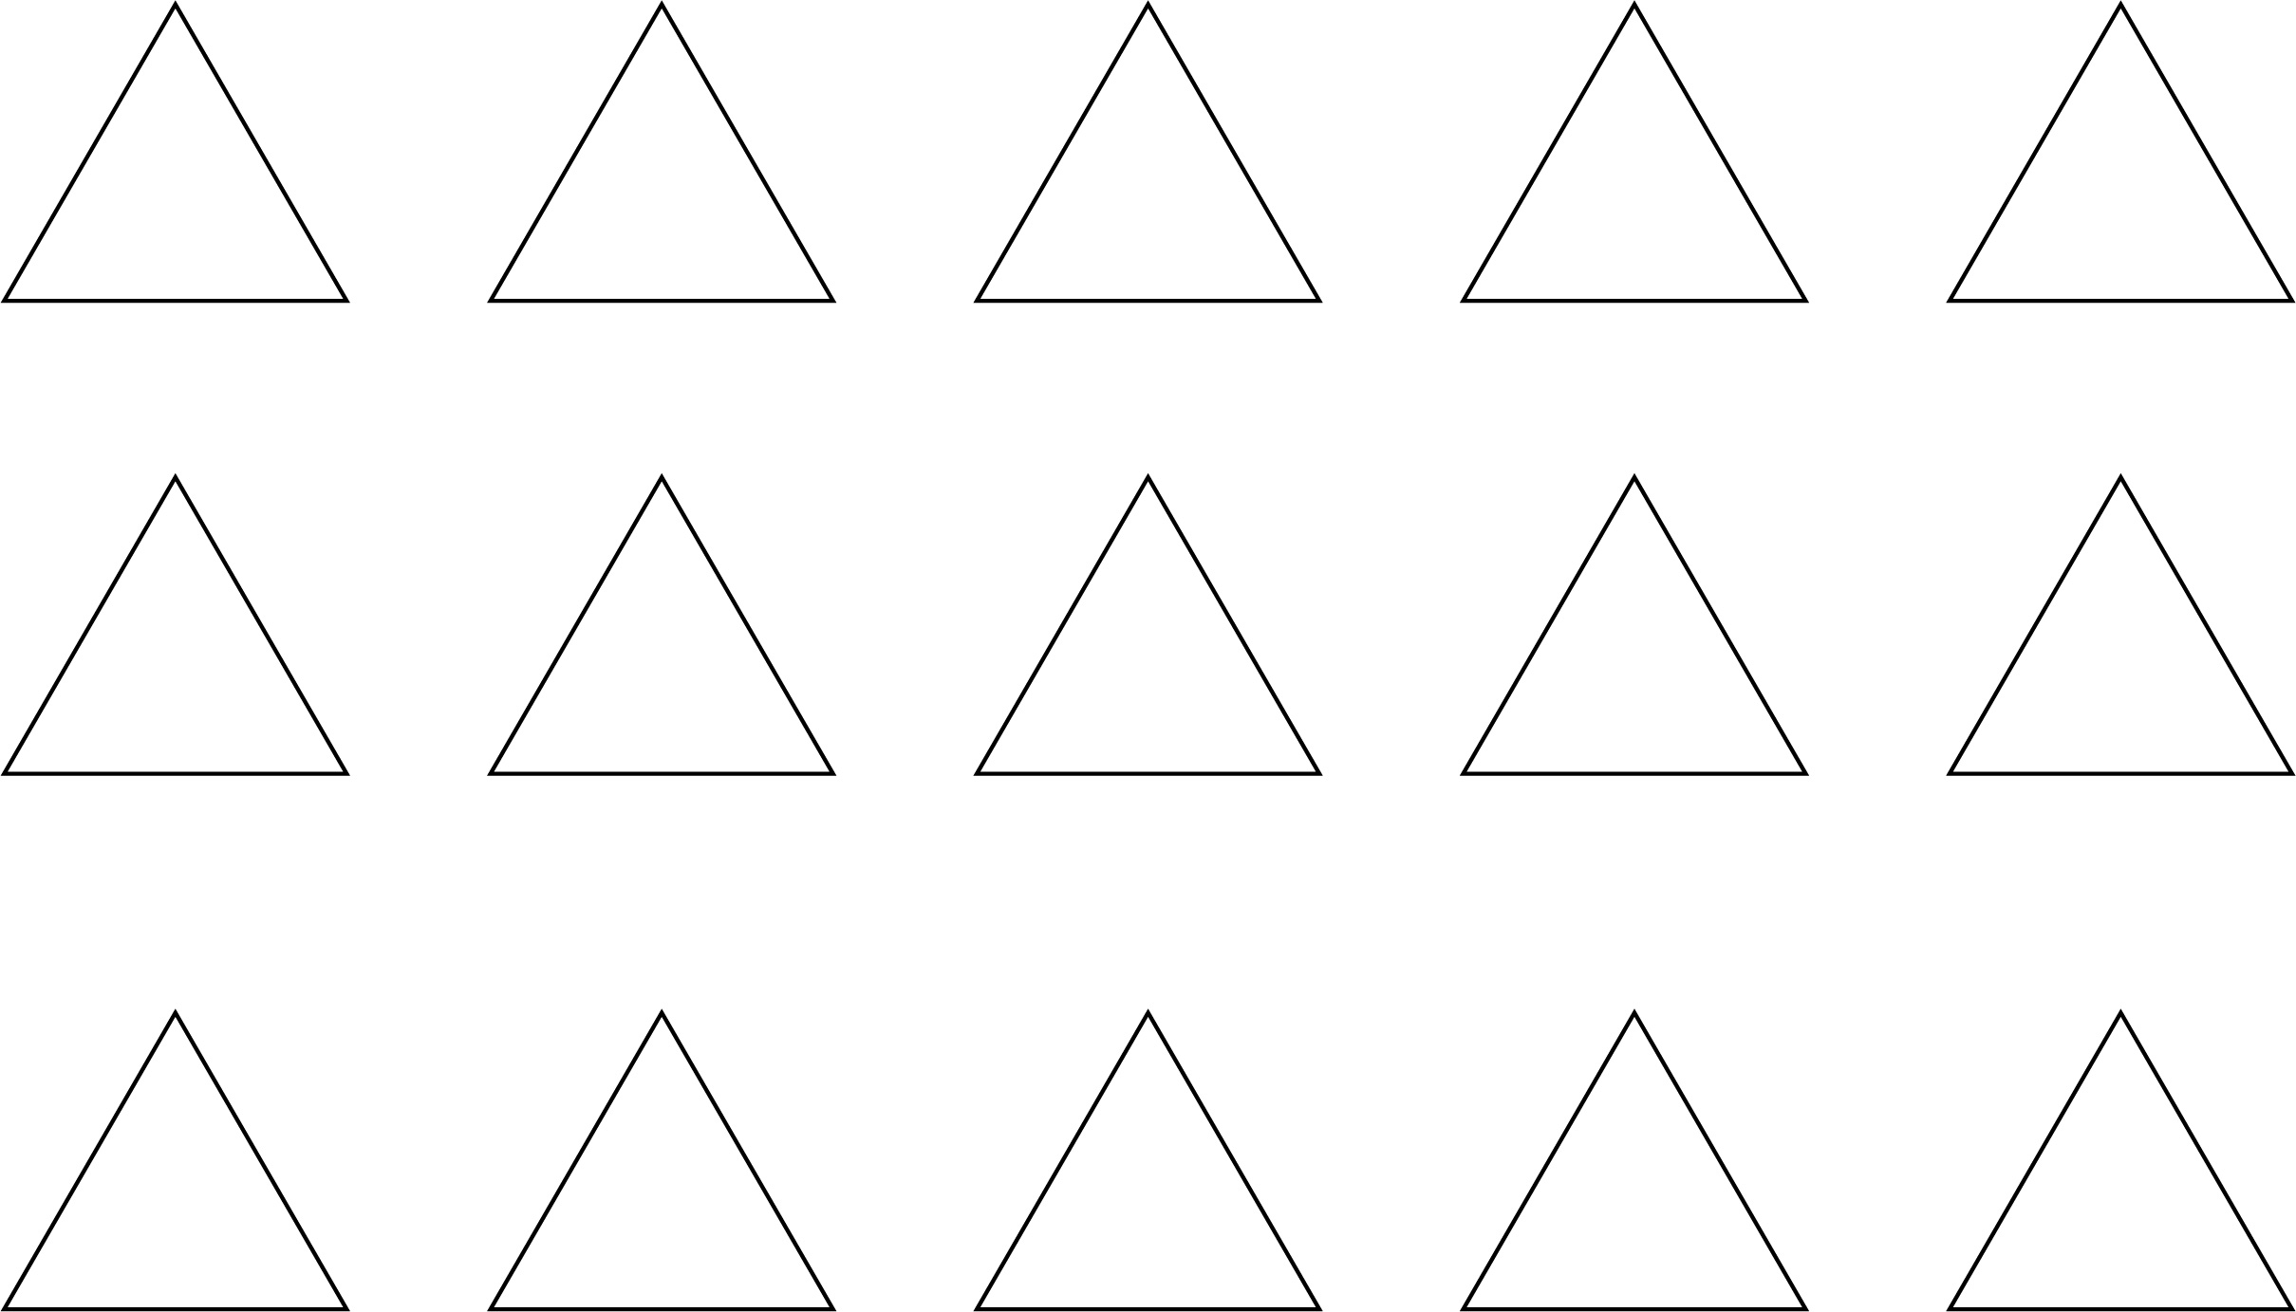
Examples of Tactile Graphics Worksheets
(cont.)
Perkins School for the Blind (Becky Vercollone, Elise Tabor)
Fractions. Mark an X in 1/3 of the triangles.
Figure 4: Fractions Exercises: 180 Days of Math for Fourth Grade, Shell Education

Slide 35
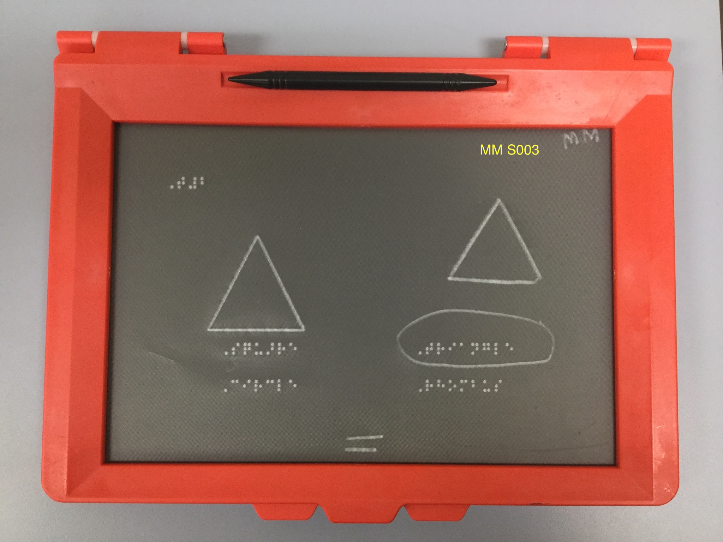

Slide 36
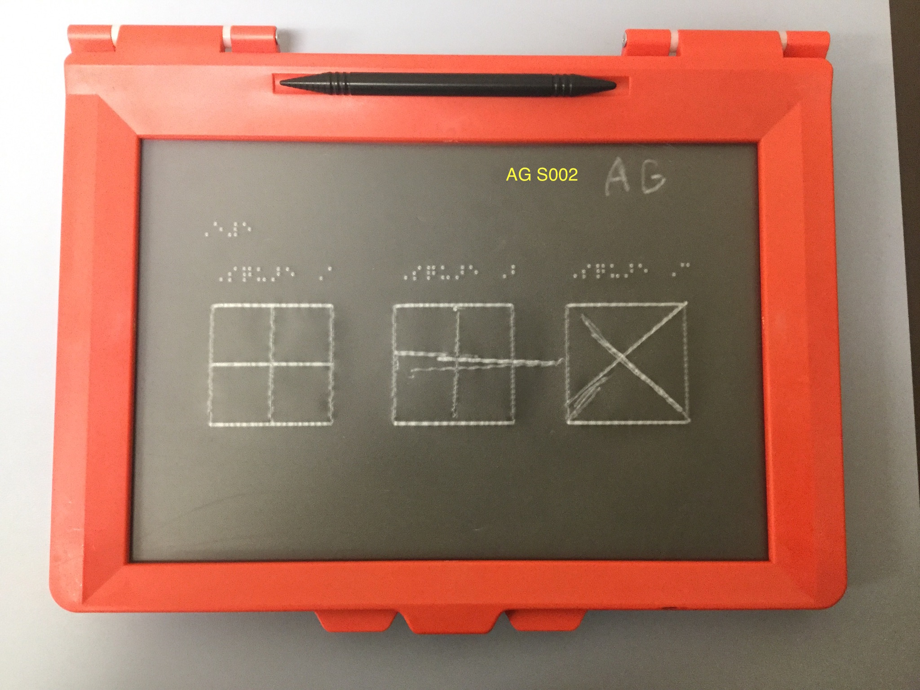

Slide 37
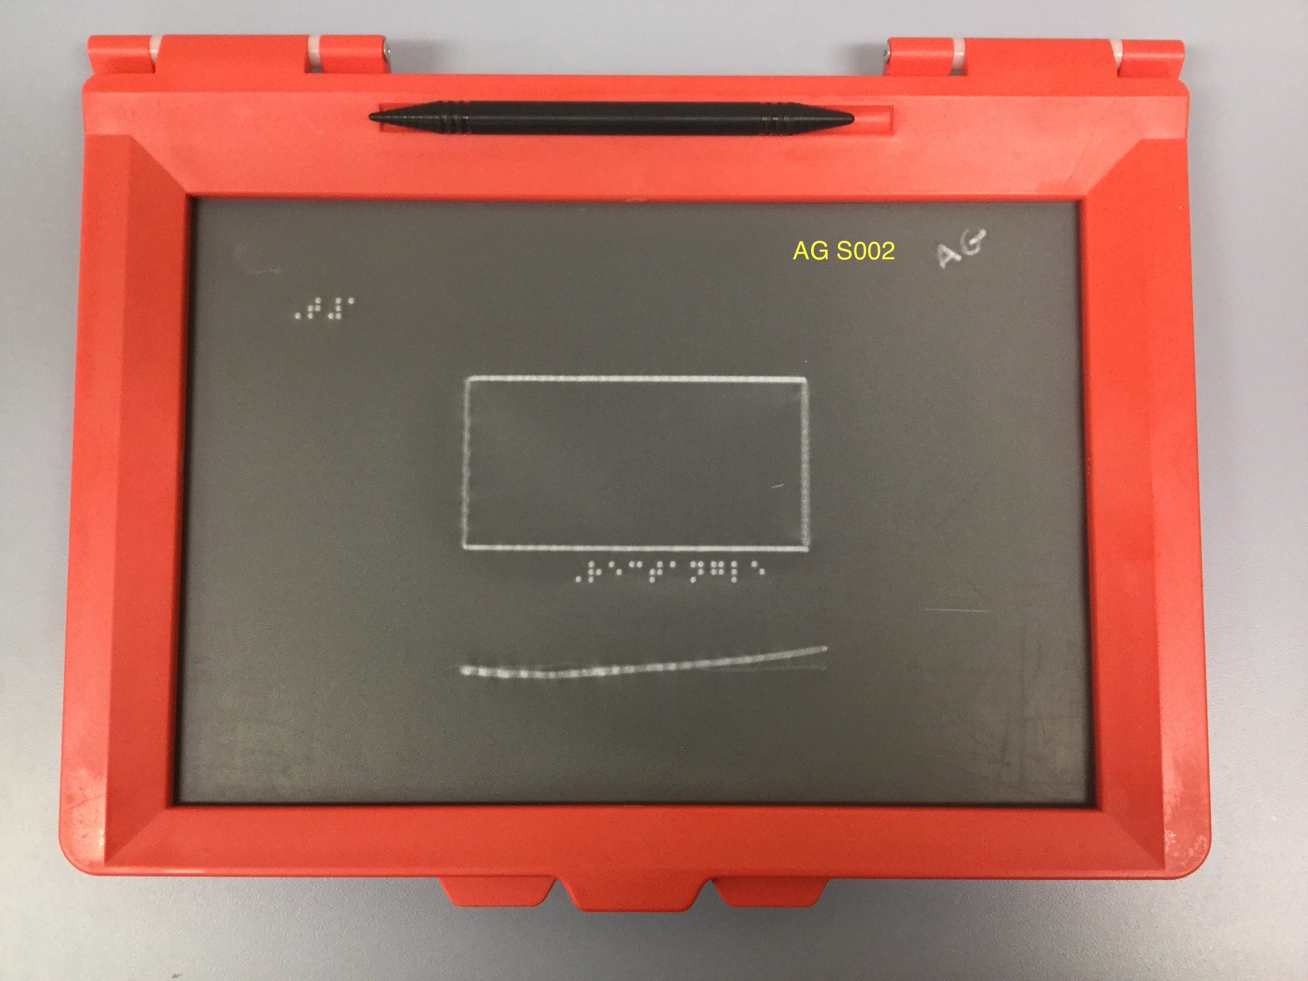

Slide 38
Professional profiles

Slide 39
Data-taking surveys
Google Forms
  Responses from students and instructors
  Response types:
    Subjective reactions (question responses and open-ended)
      3 dimensions: enjoyment, effort, and teaching/learning value
    Subjective ratings
    Objective performance/effectiveness scores
Still pictures and video
Students’ completed worksheets themselves

Slide 40
Surveys, each one for instructors and students
Personal profiles
Responses to a particular worksheet
Responses to a group (a whole course) of worksheets

Slide 41
Selected responses
Instructors reported…
  particular motor difficulty experienced in using drawing tools (rulers, calipers)
  earlier start with drawing would have been important.
  too much variance to generalize so far.
Five students at TSBVI:
  All liked drawing with stencils…
  but rated it from easy to very hard

Slide 42
Selected teacher quotes
“… Students didn't take "longer than I expected" to get familiar with the Sketchpad--they took to it like the proverbial ducks to water. It was mastering the skills that took longer.
“… This experience reminded me of how much learning takes place incidentally--for students with typical sight. Just the act of holding the stylus was a challenge for my students, as was pressing hard enough to make a "good" line. Meanwhile, their peers with typical sight have been holding pencils--and crayons and pens--since they were toddlers, learning to hold the tool and make marks with ever-increasing control, with no formal instruction …”
“It would be nice to be able to create our own worksheets and/or have a resource for doing that online and/or be able to shop a worksheet repository.”

Slide 43
Interactive Tactile Graphics Worksheets:
NFB BELL Programs, 2017: Clara Van Gerven, Carlton Walker

Slide 46
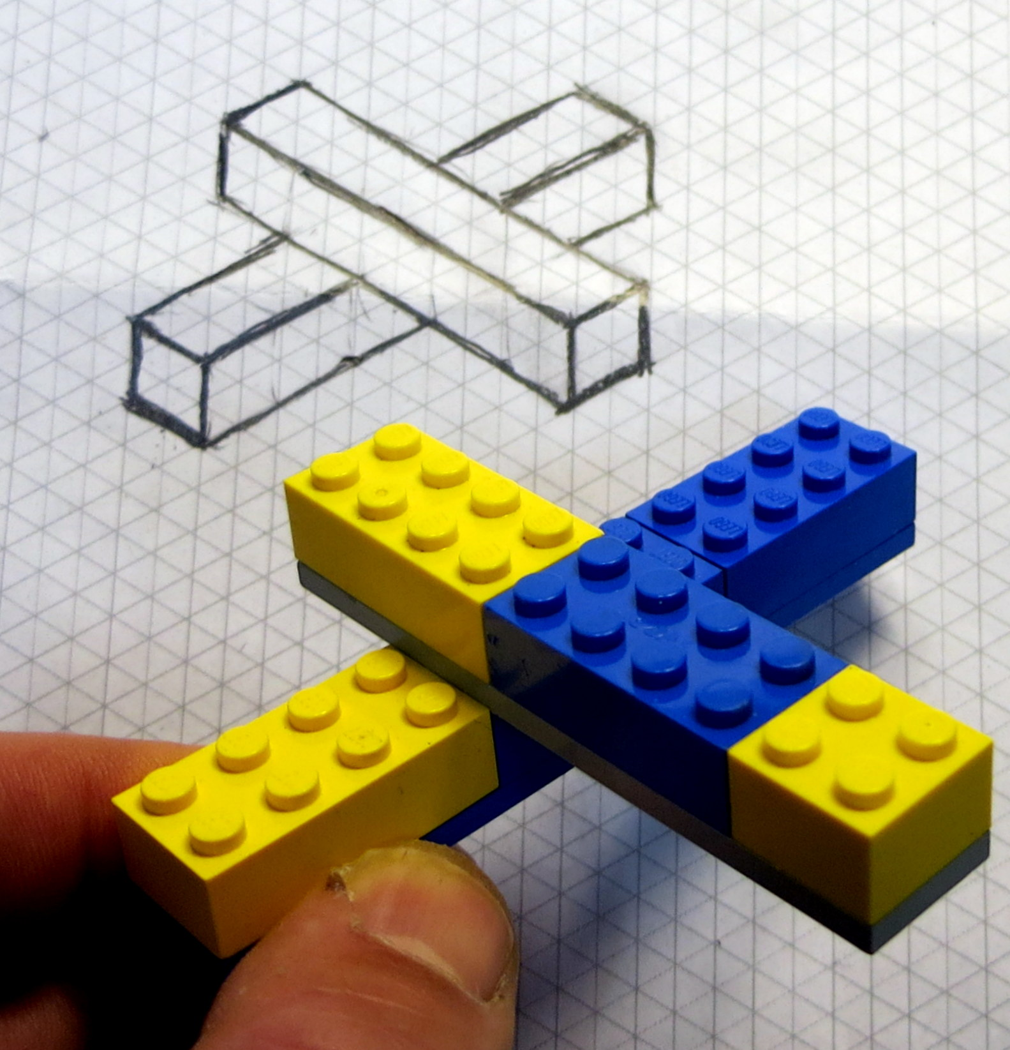
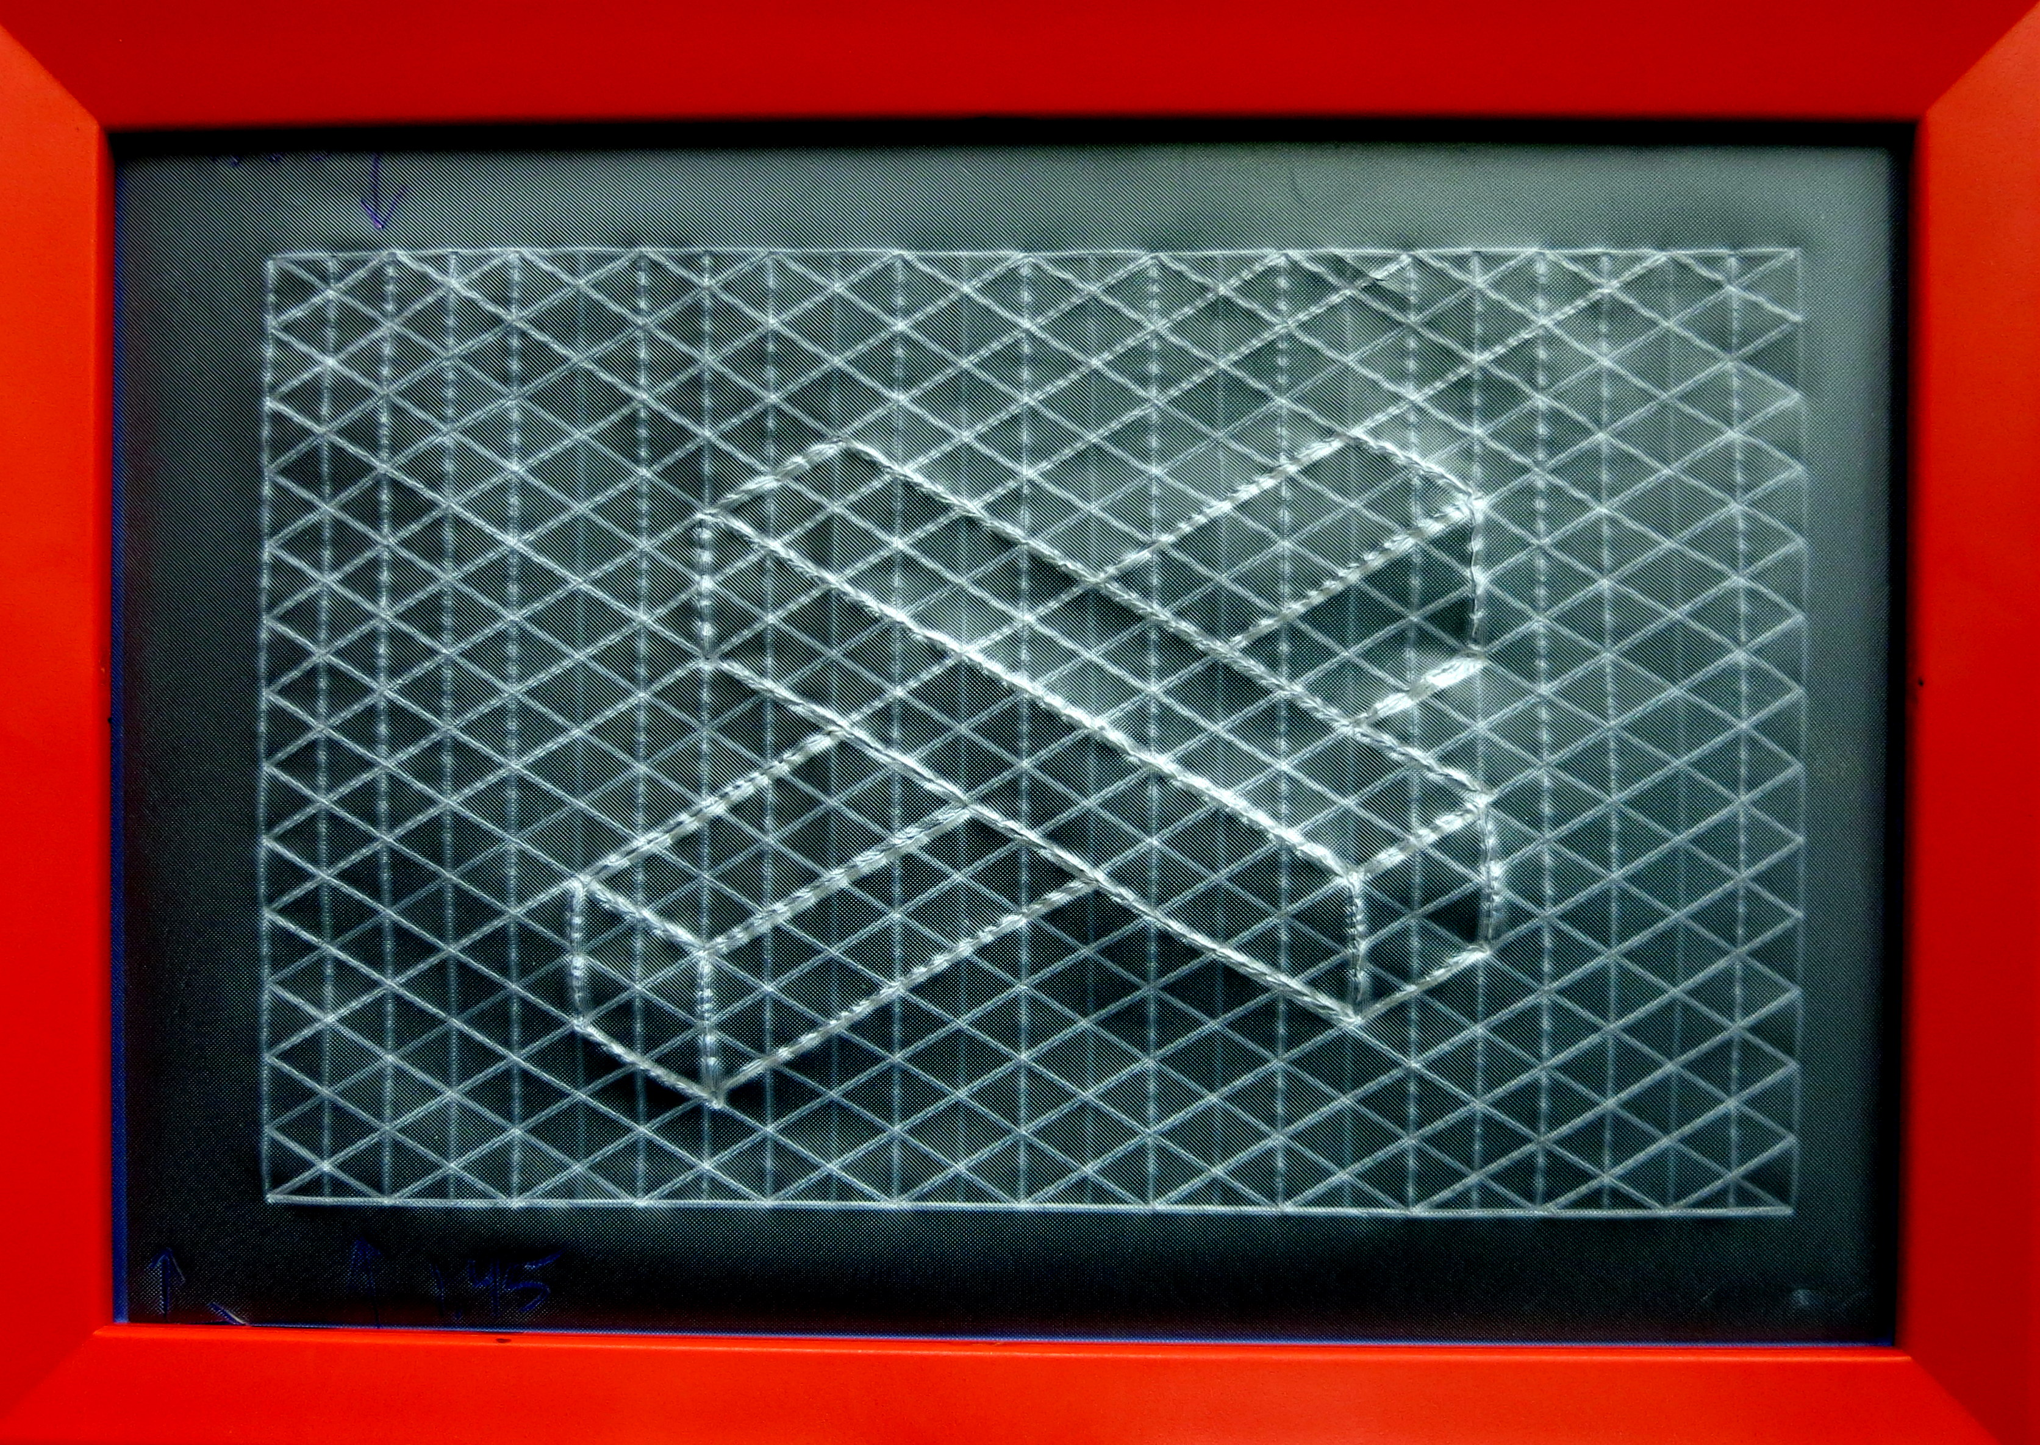

Slide 47
THANKS!!!
You, the audience …
Our Collaborators, especially TSBVI, Perkins, LA Center NFB,
Susan Osterhaus, Margaret Edwards, John Rose, Maylene Bird, Scott Kelley, Sue Mattson, Laura Hospital (TSBVI)
Becky Vercollone, Elise Edwards, Sue Shannon (Perkins)
Eric and Crystal Guillory (LA Center)
Allie Futty (VABVI)

